Slide 1
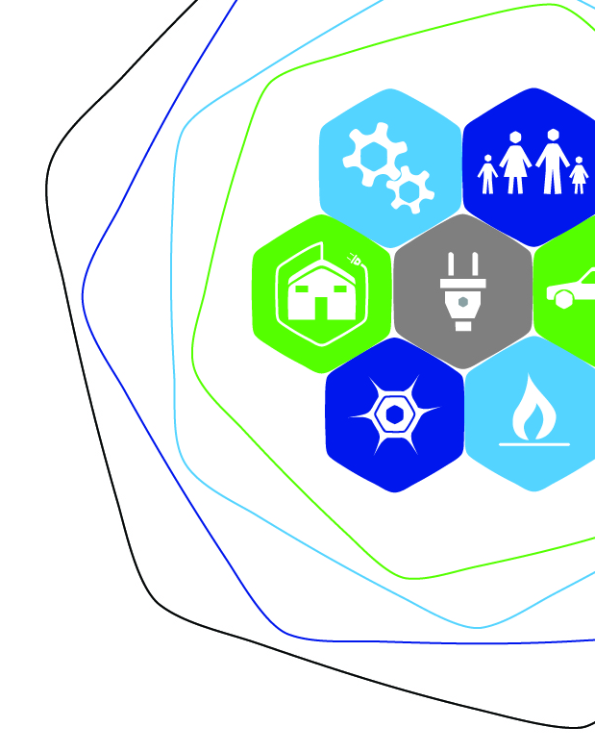



Slide 2


Office of Regulatory Staff
Energy Office
SECTION 48-52-410. State Energy Office established; purpose.
”There is established the State Energy Office within the Office of Regulatory Staff which shall serve as the principal energy planning entity for the State. Its primary purpose is to develop and implement a well-balanced energy strategy and to increase the efficiency of use of all energy sources throughout South Carolina through the implementation of the Plan for State Energy Policy.”
2016 SOUTH CAROLINA STATE ENERGY PLAN
2016 SOUTH CAROLINA STATE ENERGY PLAN
1

Slide 3

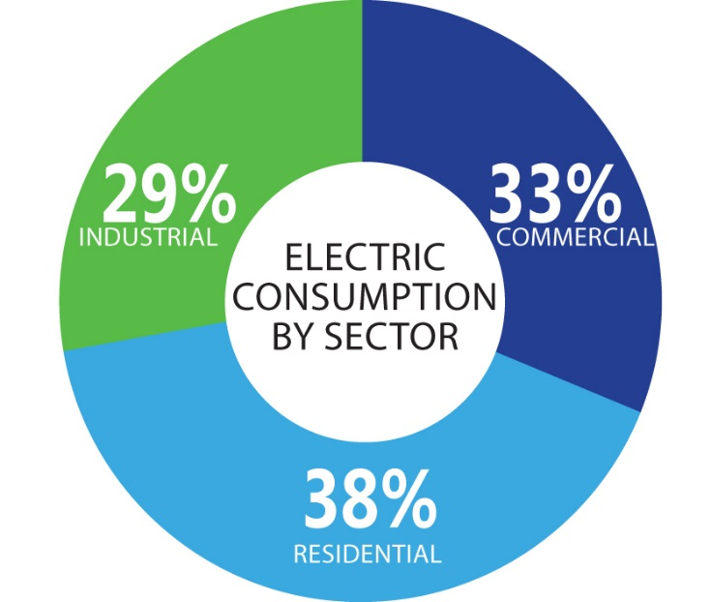
Purpose of the State Energy Plan
Pursuant to 48-52-210:
“(A) It is the policy of this State to have a comprehensive state energy plan that maximizes to the extent practical environmental quality and energy conservation and efficiency and minimizes the cost of energy throughout the State. To implement this policy there is adopted the Plan for State Energy Policy.”
2016 SOUTH CAROLINA STATE ENERGY PLAN
2

Slide 4

State Energy Plan Development
Steering Committee
  Conservation Organizations
  Cooperatives
  Investor-owned Utilities
  Large Industrial Companies
  Municipal Systems
  Santee Cooper
  SC Department of Health and Environmental Control
  State Regulation of Public Utilities Review Committee staff
PREPARED BY: OFFICE OF REGULATORY STAFF // SOUTH CAROLINA STATE ENERGY PLAN
2016 SOUTH CAROLINA STATE ENERGY PLAN
3

Slide 5
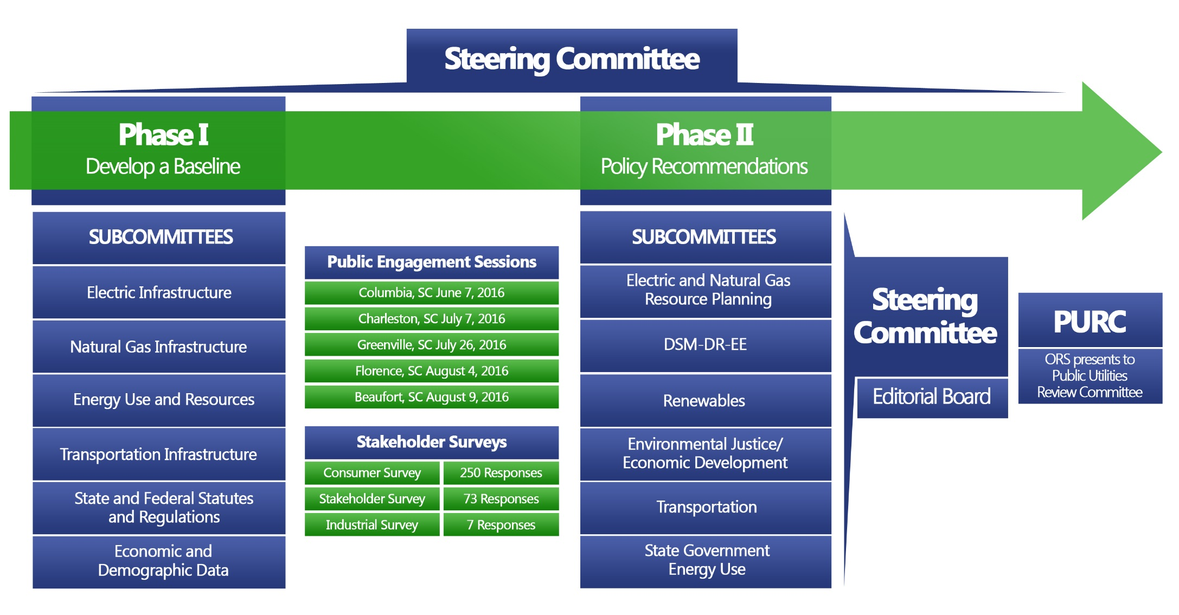
State Energy Plan Development
PREPARED BY: OFFICE OF REGULATORY STAFF // SOUTH CAROLINA STATE ENERGY PLAN
2016 SOUTH CAROLINA STATE ENERGY PLAN
4

Slide 6
Phase I
Develop a Baseline
Determine Starting Point
Electric Infrastructure
Natural Gas Infrastructure
Transportation Infrastructure
Energy Use and Resources
State and Federal Statutes/Regulations
Economic and Demographic Data
2016 SOUTH CAROLINA STATE ENERGY PLAN
5

Slide 7
Phase I
Collaboration
January 2016:
  Initial Public Engagement Sessions
  Steering Committee (1st meeting)
Spring 2016: Phase I (Baseline) plan development
  May/June: Phase I Subcommittee Meetings
  June: Phase I Draft released for public comment
  Summer 2016: Public Engagement Sessions
    June 7: Columbia SC, DHEC
    July 7: Charleston SC, North Charleston City Hall
    July 26: Greenville SC, Greenville Hughes Main Library
    August 4: Florence SC, Drs. Bruce & Lee Foundation Library
    August 9: Beaufort SC, Technical College of the Lowcountry
PREPARED BY: OFFICE OF REGULATORY STAFF // SOUTH CAROLINA STATE ENERGY PLAN
2016 SOUTH CAROLINA STATE ENERGY PLAN
6

Slide 8
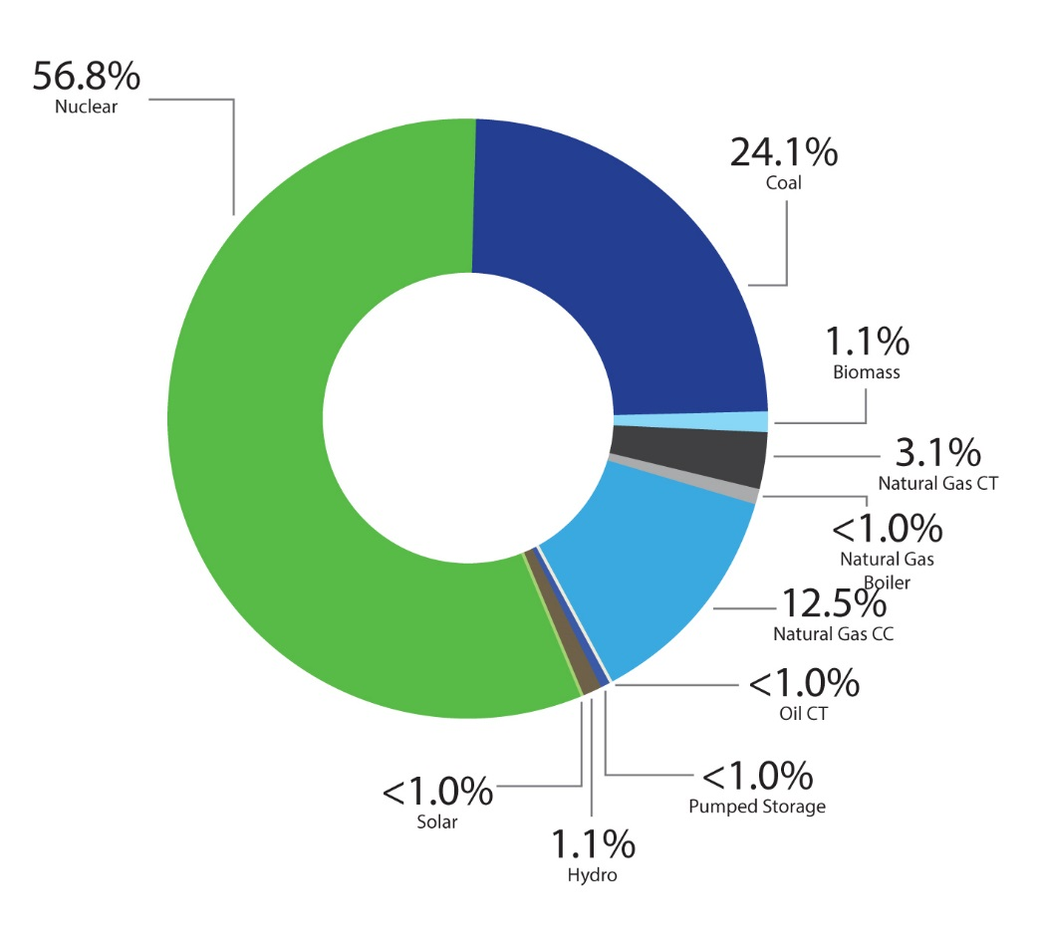
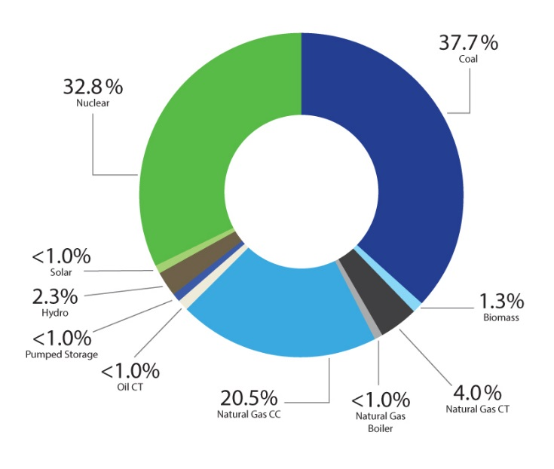
SC Generation and Allocation
2015 Generation
2015 Pro Rata Share
2016 SOUTH CAROLINA STATE ENERGY PLAN
7

Slide 9
Phase II
Policy Recommendations
Determine Next Steps: Where we go from here
Electric and Natural Gas Resource Planning
Demand Side Management–Demand Response-Energy Efficiency
Environmental Justice/Economic Development
Transportation
State Government Energy Use Policy Review
Renewables
2016 SOUTH CAROLINA STATE ENERGY PLAN
8

Slide 10
Phase II
Policy Recommendations
Integrated Resource Planning and Opt Out Study
Natural Gas Infrastructure
Economic Development
Bldg Energy Labeling, Appliance Stds, and IECC Codes
On-Bill Financing Options and Public Benefit Fund and Funding/Tax Credits
EJ Task Force: Assessments, ROW Maintenance, Advisory Panel
EE in Rental and Public Housing
Nuclear Relicensing/Renewals
Residential Energy Storage
Decommissioning Solar Farms, Best Practices, and PV Penetration Study
Acceptable Waste-to-Energy and Biofuels
Nodes: Alternative Fuel Infrastructure
Complete Streets/Planning, Transit, and Connectivity
Lead by Example: State Targets
Centers for Applied R&D
Regulatory Framework
2016 SOUTH CAROLINA STATE ENERGY PLAN
PREPARED BY: OFFICE OF REGULATORY STAFF // SOUTH CAROLINA STATE ENERGY PLAN
9

Slide 11

Integrated Resource Planning
Challenge: Ensure that electric utility Integrated Resource Plans clearly demonstrate and reflect access to energy supplies at the lowest practical environmental and economic cost and demand-side options are pursued wherever economically and environmentally practical.
Approach: Study Committee to examine cost/benefit that can be achieved by various changes to the process
PREPARED BY: OFFICE OF REGULATORY STAFF // SOUTH CAROLINA STATE ENERGY PLAN
2016 SOUTH CAROLINA STATE ENERGY PLAN
10

Slide 12

Natural Gas Infrastructure
Challenge: Ensure that natural gas is a viable energy option for residential, commercial, industrial, and power generation customers across South Carolina and enable the state to continue to attract economic development prospects.
Approach: Study Committee to consider issues that prevent access
2016 SOUTH CAROLINA STATE ENERGY PLAN
11

Slide 13

Building Codes
Challenge: Ensure that buildings owned or leased by the state of South Carolina are designed to minimize operational costs for energy. Prevent South Carolina from falling behind other states as energy codes advance.
Approach: Task Force to examine adoption of newest efficiency standards
2016 SOUTH CAROLINA STATE ENERGY PLAN
12

Slide 14

Energy Upgrades
Challenge: Develop the necessary funds to advance energy efficiency, renewable energy, and alternative transportation opportunities that support policy goals. Currently, South Carolina lacks a revenue stream to support these efforts.
Approach: Study Committee to examine solution to problems with funding energy efficiency and clean transportation
PREPARED BY: OFFICE OF REGULATORY STAFF // SOUTH CAROLINA STATE ENERGY PLAN
2016 SOUTH CAROLINA STATE ENERGY PLAN
13

Slide 15

Act 236 – Version 2.0
Challenge: Determine the needs of the state in terms of renewable energy in the context of Act 236 and beyond.
Approach: Study Committee to consider progress made; program modification required for advanced/integrated grid; opportunities to enhance infrastructure modernization, expansion, and reliability
PREPARED BY: OFFICE OF REGULATORY STAFF // SOUTH CAROLINA STATE ENERGY PLAN
2016 SOUTH CAROLINA STATE ENERGY PLAN
14

Slide 16

Environmental Justice
Challenge: Develop ways to coordinate government action to ensure it does not inadvertently affect environmental justice communities because of compounding impacts and/or cumulative effects of various stressors. Multiple agencies may have responsibilities in this arena, with minimal coordination among them.
Approach: Establish EJ advisory panel to serve as a “think tank” and resource center
2016 SOUTH CAROLINA STATE ENERGY PLAN
15

Slide 17

Lead by Example
Challenge: Look for ways to increase the adoption of alternative fuels. Currently, only a small portion of state-owned or leased fleet vehicles are fueled by a Department of Energy established alternative fuel. As a result, South Carolina’s fleet lacks diversity, and fuel supply is vulnerable. These limitations compromise fuel efficiency and diversity in transportation.
Approach: Conduct a survey and convene a task force to 1) educate 2) identify barriers and 3) develop recommendations/state-wide goals
PREPARED BY: OFFICE OF REGULATORY STAFF // SOUTH CAROLINA STATE ENERGY PLAN
2016 SOUTH CAROLINA STATE ENERGY PLAN
16

Slide 18

State Energy Efficiency
Challenge: Pursue developing a policy to approve (qualification-based) selection of firms to perform energy audits. Currently, the process of performing energy audits, as a precursor to state agency energy efficiency retrofits, can be very difficult.
Approach: Develop a policy for presentation to the State Fiscal Accountability Authority to consider (qualification-based selection of firms to perform audits)
PREPARED BY: OFFICE OF REGULATORY STAFF // SOUTH CAROLINA STATE ENERGY PLAN
2016 SOUTH CAROLINA STATE ENERGY PLAN
17

Slide 19
Many recommendations suggest forming study committees to do the work necessary to develop practical solutions. We will now turn to developing these committees.
Submit comments:
scenergyplan@regstaff.sc.gov

Slide 20


